Slide 1

CFA Society Los Angeles
Ethics: Module 5
Overview of the Global Investment Performance Standards
Winter 2024
Presented by:
Kim Cash, CFA, CAIA, CIPM, CSCP
kim.cash@cascadecompliance.com

Slide 2
The GIPS® Standards - Objectives
Five objectives of the Global Investment Performance Standards:
  Promote investor interests and instill investor confidence
    Based on fair representation and full disclosure
  Ensure accurate and consistent performance data
  Obtain worldwide acceptance of a single standard for calculating and presenting performance
  Promote fair, global competition among investment firms, and
  Promote industry self regulation on a global basis
Discuss the objectives and scope of the GIPS standards and their benefits to prospective clients and investors, as well as investment managers.

Slide 3



SCOPE
Calculation Methodologies
Inputs
1 2 3
Discuss the objectives and scope of the GIPS standards and their benefits to prospective clients and investors, as well as investment managers.

Slide 4



Objectives+ Scope
Calculation Methodologies
Inputs
V
COMPOSITES & POOLED FUNDS

Slide 5
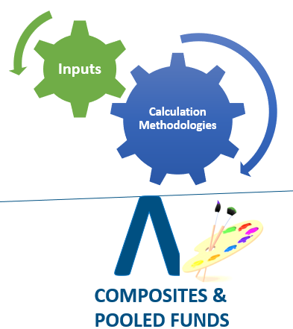
Scope
Voluntary, ethical* rules governing firms, asset owners and verifiers, and include
requirements and recommendations
For Firms:
    Fundamentals of compliance
    Input data and calculation methodology
    Composite and Pooled Fund Maintenance
    GIPS Reports:
      TWR Composite
      MWR Composite
      TWR Pooled Fund
      MWR Pooled Fund
    GIPS Advertising Guidelines
Discuss the objectives and scope of the GIPS standards and their benefits to prospective clients and investors, as well as investment managers.

Slide 6
Scope
To claim compliance:
    All applicable requirements - minimum that must be followed firmwide
    Recommendations – best practices that should be followed
    Guidance Statements, interpretations, Q&A and clarifications
Discuss the objectives and scope of the GIPS standards and their benefits to prospective clients and investors, as well as investment managers.

Slide 7
Benefits
To prospective clients/investors
    Facilitate a dialogue between managers and prospective clients and investors
    Increased confidence in the accuracy of presentations
    Comparability among managers and overtime
For investment managers:
    Voluntary compliance adds credibility to the firm
    Often required by institutional consultants/clients
    Broad adoption improves the industry’s credibility
    Strengthen managerial controls
Discuss the objectives and scope of the GIPS standards and their benefits to prospective clients and investors, as well as investment managers.

Slide 8
Fundamentals: Definition of FIRM and discretion
Firm:
  Can be a registered firm, or a subsidiary, or division
  held out to clients or potential clients as a distinct business entity
Discretion:
  GIPS discretion ≠ regulatory discretion
  Is the manager able to implement the intended investment strategy?
  Do client restrictions prevent the manager from implementing the intended strategy?
Non-discretionary examples:
  No tobacco, alcohol or fire arms
  Limits on security/sector weights
  Regular and ongoing cash withdrawals
b: Explain the fundamentals of compliance with the GIPS standards, including the definition of the firm and the firm’s definition of discretion.

Slide 9
Other Fundamentals of compliance
Firms must comply initially for at least 5 years or since inception of the firm
Firms must comply with all of the requirements of the GIPS standards, including applicable laws and regulations regarding the calculation and presentation of performance
  No “except for”
  No calculated “consistent with” or “in accordance” with
  No false or misleading performance information
  If a conflict exists between the GIPS standards and law, obey the law and disclose the conflict
If requested, firms must provide a:
  Complete List of Composite and LDPF Descriptions, and a list of BDPFs
    The list must include terminated composites for up to 5 years, but not terminated funds
    GIPS Reports for any composite or LDPF on the list
Use of Total Return Benchmarks reflective of the presented composite or pooled fund
b: Explain the fundamentals of compliance with the GIPS standards, including the definition of the firm and the firm’s definition of discretion.

Slide 10
Question 1:
Which statement most accurately expresses a requirement of the GIPS standards?
A. Non-fee-paying portfolios must not be included in composites.
B. All actual fee-paying discretionary segregated accounts must be included in at least one composite.
C. All actual fee-paying discretionary segregated accounts must be included in only one composite.

Slide 11
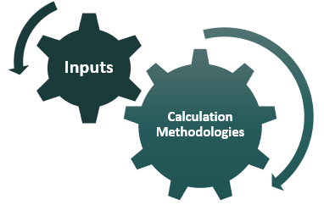
Return calculation methodology
  Total returns must be used. Firms must present time-weighted returns (TWRs), unless strategy meets certain requirements to present MWRs.
  A total return captures both the return from realized and unrealized capital gains and investment income
    REMEMBER: include accrued interest income
  Beginning 1/1/2005, firms must adjust for daily weighted external cash flows
  Beginning 1/1/2010, firms must revalue on the date of all large cash flows, and as of each calendar month end or the last business day of each month
  Monthly and sub-period returns must be geometrically linked
Discuss the requirements of the GIPS standards with respect to return calculation methodologies, including the treatment of external cash flows, cash and cash equivalents, and expenses and fees.

Slide 12

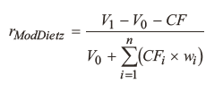
Time Weighted Return calculation methodology
Total return
Adjusted for day weighted cash flows
Revalued for large cash flows – sub-periods in between monthly valuations
Geometrically linked
Discuss the requirements of the GIPS standards with respect to return calculation methodologies, including the treatment of external cash flows, cash and cash equivalents, and expenses and fees.

Slide 13
Return calculation methodology
    (EFMV – BFMV – Cash Flow) / (BFMV + Cash Flow)
    Feb 1 BFMV: 100
    Feb 28 EFMV: 130
    Feb 21 CF: -20
    __
    Feb 21 FMV: 140
    Dietz = (130 – 100 –(-20)) / (100 + (-20/2) = 50 / 90 = 55.56%
    Modified Dietz = (130 – 100 –(-20) / (100 + (-5)*) = 50 / 95 = 52.63%
    Revalued = (140-100)/100 = 40%
            (130-140-(-20) / 140+(-20) = 10/120 = 8.33%
            Linked: 1.4 * 1.0833 - 1 = 51.67%
    *(-20)(28-21/28))
Discuss the requirements of the GIPS standards with respect to return calculation methodologies, including the treatment of external cash flows, cash and cash equivalents, and expenses and fees.

Slide 14
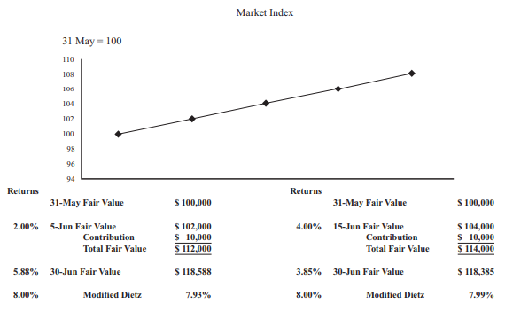
Effects of external cash flows
In relatively flat, steadily rising or steadily falling markets, the timing of cash flows has a relatively small impact on the accuracy of returns.
From Ethics: Module 5
Source: Paula Gehr
Discuss the requirements of the GIPS standards with respect to return calculation methodologies, including the treatment of external cash flows, cash and cash equivalents, and expenses and fees.

Slide 15
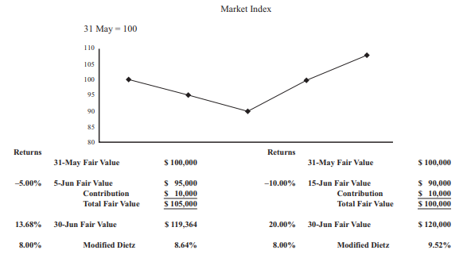
Effects of external cash flows
When the market turns volatile, the impacts of external cash flows have a material impact on the accuracy of returns.
From Ethics: Module 5
Source: Paula Gehr
Discuss the requirements of the GIPS standards with respect to return calculation methodologies, including the treatment of external cash flows, cash and cash equivalents, and expenses and fees.

Slide 16
Money-Weighted Returns
  Criteria to be able to choose to present MWRs:
  Control over the timing of the external flows, and
    Portfolios are closed-end, fixed life or fixed commitment or
    Illiquid investments are a significant part of the investment strategy.
  TWRs = MWRs if there are no cash flows
Discuss the requirements of the GIPS standards with respect to return calculation methodologies, including the treatment of external cash flows, cash and cash equivalents, and expenses and fees.

Slide 17
Treatment of cash, expenses and fees
  Returns from cash must be included
  Impact of holding cash:
    Reduce returns in up markets
    Improve returns in down markets
Returns must be calculated after the deduction of trading expenses
  Typically deducted at point of trade: commissions, bid/ask spreads
  BOTH GROSS AND NET Performance must be net of trading expenses
  BUNDLED FEES: If trading expenses and custody fees are part of a bundled all-in fee, firms must reduce gross returns by the entire bundled fee or the portion that includes transaction costs. Alternatively, firms can estimate transaction costs.
Discuss the requirements of the GIPS standards with respect to return calculation methodologies, including the treatment of external cash flows, cash and cash equivalents, and expenses and fees.

Slide 18
Treatment of cash, expenses and fees
Management fees:
  Can be actual or model; accruing fees and expenses is recommended
  Management fees, including performance-based fees, are the only difference between NET and GROSS PERFORMANCE
  Lots of disclosure requirements
Custodial fees and other administrative expenses:
  Do not affect performance: Beyond a manager’s control for composite returns – impact not reflected in performance
  Do affect net performance for pooled funds: within a manager’s control
  For calculation purposes for composites – treat like an external cash withdrawal made by a client: EMV – BMV – custodial fee/ BMV
Discuss the requirements of the GIPS standards with respect to return calculation methodologies, including the treatment of external cash flows, cash and cash equivalents, and expenses and fees.

Slide 19
Question 2:
Under the GIPS standards, the most accurate statement is that transaction costs
do not include:
A. spreads from internal brokers.
B. brokerage commissions.
C. custody fees charged per transaction.

Slide 20
2.B.6 Valuation Hierarchy
First Choice: Investments must be valued using objective, observable, unadjusted quoted market
prices for identical investments in active markets on the measurement date, if available.
2nd Priority: For similar investments in active markets
3rd Priority: For identical or similar investments in inactive markets
4th Priority: Observable, market-based inputs, other than quoted prices
5th Priority: Subjective, unobservable inputs where markets are inactive at measurement date.
Explain the recommended valuation hierarchy of the GIPS standards

Slide 21
Composite TWR return calculations
  Must use an asset-weighted average of the portfolio returns
  The portfolios or an aggregate of the composite must be weighted using:
    Beginning of period values, or
    Beginning of period values, adjusted for cash flows
  What would happen if portfolios are weighted using ending values?
    Best performers would get more weight
    Worst performers would get less weight
  Composite returns must be calculated at least monthly.
  Periods of less than one year must NOT be annualized.
Explain the requirements and recommendations of the GIPS standards with respect to composite return calculations, including methods for asset-weighting portfolio returns.

Slide 22

Composite Construction
All actual, fee-paying, discretionary portfolios must be included in at least one composite.
  Non-feepaying accounts may be included, along with a presentation requirement to disclose the % of nonfeepaying assets
  Non-discretionary accounts must not be included
  Portfolios that are not actual accounts must not be included
  Pooled funds that meet composite definition must be included
GIPS discretion ≠ regulatory discretion
Discretion:
  Is the manager able to implement the intended investment strategy?
  The answer will differ from firm to firm, and strategy to strategy
Explain the meaning of “discretionary” in the context of composite construction and, given a description of the relevant facts, determine whether a portfolio is likely to be considered discretionary.

Slide 23
For discussion:
Discretionary or Nondiscretionary?
Limits on derivatives in a portfolio that doesn’t use derivatives
Regular and ongoing cash flows in a:
  U.S. Large cap equity portfolio – large institutional account
  U.S. Large cap equity portfolio – small retail account
  International small cap portfolio
Explain the meaning of “discretionary” in the context of composite construction and, given a description of the relevant facts, determine whether a portfolio is likely to be considered discretionary.

Slide 24
Question 3
A fixed-income portfolio is most likely to be considered non-discretionary if the client’s investment policy states that:
A. securities held at a gain must not be sold.
B. the average credit quality must be investment grade.
C. securities held in the portfolio must be issued in developed markets.
From 2020 CFA Institute. Reproduced and republished with permission from CFA Institute. All rights reserved.

Slide 25
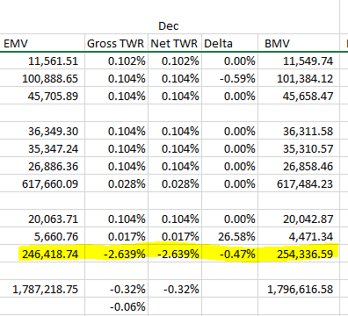
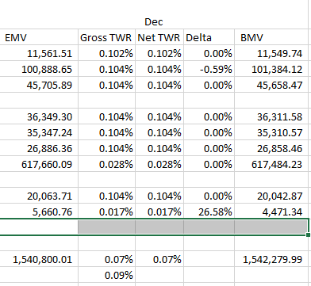
Temporary Loss of discretion example – tax loss harvesting
Fictional example; not all portfolios in the composite are shown.
Explain the meaning of “discretionary” in the context of composite construction and, given a description of the relevant facts, determine whether a portfolio is likely to be considered discretionary.

Slide 26
Composite construction
Composites must be defined according to investment mandate, objective, or strategy:
Composites must include all portfolios that meet the composite definition
Well-defined composites are essential to the firm’s marketing strategy
The GIPS guidance statement on composite definition suggests a hierarchy for composite definition that is suggested but not required
Suggested Hierarchy:
Investment mandate – Ex: Large cap global equities
Asset Class – Ex: Equity, fixed income, balanced, real estate
Style or Strategy – Ex: Growth, value, indexed, asset class sector
Benchmarks – Ex: S&P 500 index, Barclays Capital Aggregate Index
Risk/Return Characteristics –
Ex: An equity composite with a targeted excess return of 3% and targeted maximum volatility of 6%
Explain the role of investment mandates, objectives, or strategies in the construction of composites.

Slide 27
Composite construction
How many composites should a firm have?
  The firm decides how broadly defined a composite will be. There is no right or wrong answer, it is firm-specific.
  The more composites ≈ the more specific the strategy = the < smaller the assets and the smaller the dispersion
  The fewer the composites ≈ the broader the strategy = the > larger the assets and the larger the dispersion
Explain the role of investment mandates, objectives, or strategies in the construction of composites.

Slide 28
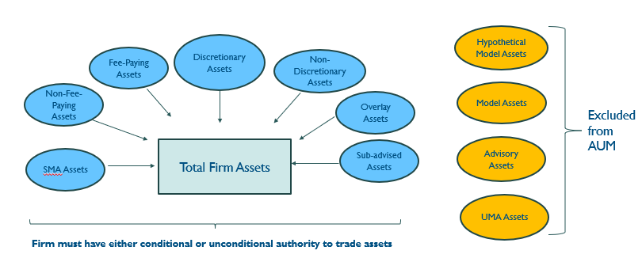
Composite construction
Composites must include only assets under management within the defined firm.
Firms are not permitted to link simulated or model portfolios with actual performance.
Uncalled Capital
© 2020, CFA Institute. Reproduced and republished with permission from CFA Institute. All rights reserved.
Explain the role of investment mandates, objectives, or strategies in the construction of composites.

Slide 29
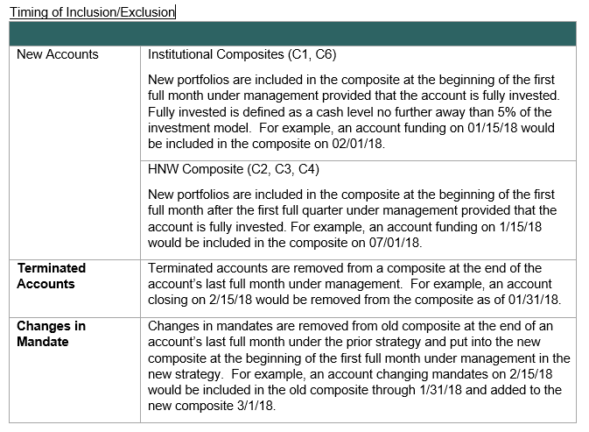
Composite construction: New / Closed account timing
Composites must include new portfolios on a timely and consistent basis.
Terminated portfolios must be included up to the last full measurement period.
Explain the requirements and recommendations of the GIPS standards with respect to composite construction, including switching portfolios among composites, the timing of the inclusion of new portfolios in composites, and the timing of the exclusion of terminated portfolios from composites.

Slide 30
Composite construction: changes in mandate, temporary accounts for scf, composite minimums
  Portfolios can only be moved from one composite to another under two scenarios
  First – if client imposed changes to the investment mandate, objective, or strategy of the portfolio cause it to no longer meet the definition of the original composite
  Second – if a redefinition of the composite makes it appropriate
  Temporary Loss of Discretion – Significant External Cash Flow
  RECOMMENDATION: firms use a temporary new account rather than removing the entire portfolio from the composite
Composite minimums:
  Minimum asset levels for a composite are optional, not recommended. This policy must be applied consistently and not retroactively
    Requires documented policies regarding consistent and timely removal if accounts fall below the minimum.
  RECOMMENDATION: avoid presenting a compliant presentation to a prospective client who is known not to meet the composite minimum
Explain the requirements and recommendations of the GIPS standards with respect to composite construction, including switching portfolios among composites, the timing of the inclusion of new portfolios in composites, and the timing of the exclusion of terminated portfolios from composites.

Slide 31
Presentation and Reporting
GIPS compliant firms must make every reasonable effort to provide a GIPS Report to all prospective clients/investors when they become a prospect
a prospective client is any person or entity that has expressed interest in one of the firm’s strategies and qualifies to invest in that strategy via a segregated account
a prospective investor is any person or entity that has expressed interest in one of the firm’s pooled funds and qualifies to invest in that fund
Includes existing clients offered new investment strategies
Prospective clients/investors must receive an updated GIPS Report with the most recent
annual performance at least once every 12 months if the prospect remains a prospect
Firms must be able to demonstrate how this requirement was satisfied
Explain requirements of the GIPS standards with respect to presentation and reporting.

Slide 32
Presentation and Reporting
Two Types of reports: GIPS Composite Reports and GIPS Pooled Funds Reports
Minimum 5 years performance (or since inception) extended each year thereafter leading up to 10 years
Key elements of Composite TWR Report (presented for each period end) :
Composite and benchmark annual returns
Number of portfolios (if six or more) in the composite
Amount of assets in the composite
Total firm assets under management
Internal dispersion (if six or more portfolios)
Three-year annualized ex post standard deviation of the composite and benchmark (if monthly returns are available)
Explain requirements of the GIPS standards with respect to presentation and reporting.

Slide 33
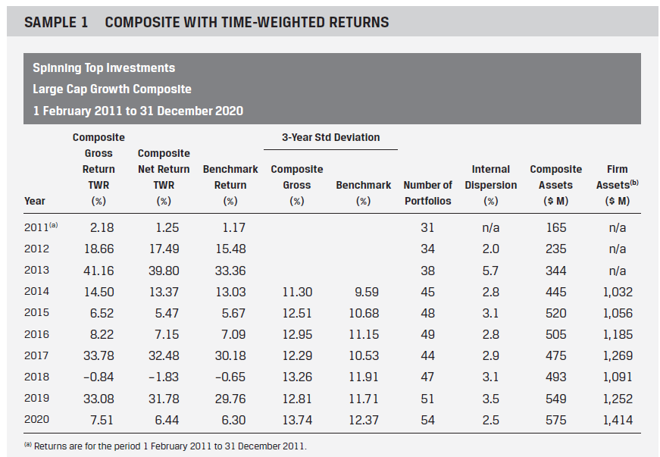
Gips compliant presentation example

Slide 34
measures of internal dispersion
  Internal dispersion: how consistently did the firm implement its intended strategy across the individual portfolios in the composite.
  A high dispersion infers a higher variability of account level returns, it may suggest that the composite is defined too broadly.
  The GIPS standards indicate acceptable measures include (but are not limited to):
High/low
Range
Equal-weighted standard deviation
Asset-weighted standard deviation
Explain requirements of the GIPS standards with respect to presentation and reporting.

Slide 35
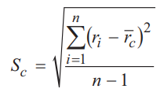
internal dispersion – Equal weighted Standard Deviation
  Slightly more difficult to calculate and interpret: the standard deviation of returns for portfolios may convey better information
    Most spreadsheet programs facilitate the calculation of equal weighted standard deviation
    Many prospective clients will have a basic understanding of standard deviation
    By giving all of the portfolios the same weight, it assumes that each portfolio is just as reflective of the investment strategy
  The equal weighted standard deviation is calculated as:
Explain requirements of the GIPS standards with respect to presentation and reporting.

Slide 36


internal dispersion – Asset weighted Standard Deviation
  Many firms chose to present the asset weighted standard deviation rather than the equal weighted.
    Asset weighted can be quite different than the equal weighted
    It indicates that larger portfolios are more reflective of the investment strategy
    The biggest drawback is that prospective clients will not know how evenly distributed the composite assets are among all of the portfolios
  The asset weighted standard deviation is calculated as:
  Where
Explain requirements of the GIPS standards with respect to presentation and reporting.

Slide 37
Portability requirements
Requirements are applied on a composite-specific basis
Substantially all investment decision makers are employed by the new or acquiring firm
The decision-making process remains substantially intact and independent within the new or acquiring firm
The new or acquiring firm has records that document and support the reported performance
There must be no break in the track record between the past firm or affiliation and the new or acquiring firm
One exception…
Firms can still port performance over to new or acquiring firm if there is a break in track record, but the two performance records may not be linked.
Firms must disclose when past performance is from a prior firm.
When a GIPS-compliant firm acquires another firm/affiliation, they are given one year to bring any non-compliant assets into compliance
Only current performance must be brought into compliance within one year of the firm acquisition—historical performance can still be ported over after the first year
Explain the conditions under which the performance of the past firm or affiliation may be linked to or used to represent the historical performance of a new or acquiring firm.

Slide 38
Purpose of verification
To provide the firm and the users of its GIPS Reports greater confidence in its claim of compliance with the GIPS standards.
Increased knowledge in the performance measurement team
Consistently higher quality of performance presentations
Improved internal processes and procedures
Market advantages
Discuss the purpose, scope, and process of verification.

Slide 39
Scope and purpose of verification
  Verification provides assurance on whether:
      (a) the firm’s policies and procedures related to composite and pooled fund maintenance, as well as the calculation, presentation, and distribution of performance have been designed in compliance with the GIPS standards, and
      (b) Have been implemented on a firm- wide basis
  A verification report must opine that the firm meets these two criteria
  The firm must not state that it has been verified unless a verification report has been issued
  Verification is firm-wide and cannot be carried out on a composite
  Verification does not provide assurance about the performance of any specific composite
  A firm may choose to have a detailed performance examination conducted on one or more specific composites or pooled funds.
Discuss the purpose, scope, and process of verification.

Slide 40
Process of verification
The minimum initial period for which verification can be performed is one year
    Or from the firm’s inception date through period-end, if less than one year
    RECOMMEND: verification cover all periods the firm claims compliance
Because verification is firm-wide, verifiers must subject the entire firm to testing, typically using a sampling methodology that must consider:
    Number of composites
    Number of portfolios in each composite
    The total assets under management
    The internal control structure of the firm
    The number of years under examination
    The methods of calculating performance
Discuss the purpose, scope, and process of verification.

Slide 41
Process of verification
  Verifiers must:
  Understand all of the requirements and recommendations of the standards
    Including guidance statements, updates, interpretations, Q&A and clarifications published by the CFA institute and GIPS executive committee
  Be knowledgeable about laws and regulations regarding the calculating and presentation of performance
  Understand the firm’s policies and procedures and ensure they are properly included and documented
  Understand the methodology used by the firm to value portfolios and compute performance
Discuss the purpose, scope, and process of verification.

Slide 42
Process of verification
  Verifiers must determine, for example:
  Portfolios are included in the correct composite
  The composite benchmark reflects the investment mandate/strategy
  The treatment of input data is consistent with the firm’s policies
    Taxes, dividends, interest, fees, disbursements
  Validate the discretionary status of portfolios included in composites and that all actual, fee-paying, discretionary portfolios are included in at least one composite
Discuss the purpose, scope, and process of verification.

Slide 43
process of verification
  Verifiers must maintain sufficient documentation supporting all procedures performed in support of the verification.
  Including receiving a representation letter from the firm confirming that the policies and procedures used in establishing and maintaining compliance are consistently applied at a firm-wide level
  Remember- verification does not provide assurance that specific composite returns are correct
Discuss the purpose, scope, and process of verification.

Slide 44
Question 4
A charitable foundation transfers securities in kind to Taurus Asset Management Ltd. to fund a new private equity portfolio. Taurus estimates that, after liquidating the transferred securities, it will take five months to invest the foundation’s assets in privately held companies. Which statement best describes a requirement of the GIPS standards? Taurus must include the foundation’s portfolio in the appropriate private equity composite:
A on a timely and consistent basis.
B when the assets are substantially invested.
C as of the beginning of the next full measurement period.

Slide 45
Question 5
After an extended period of rising interest rates, the market value of Hartford Special Machinery Company’s core-plus fixed-income portfolio falls below the composite minimum of $10 million. The Hartford portfolio remains below the composite-specific minimum asset level for nine months until the client makes an additional contribution that brings it back above $10 million in assets. Belltower must:
A temporarily switch the Hartford portfolio to the firm’s miscellaneous composite.
B include the Hartford portfolio in the core-plus fixed income composite in all measurement periods.
C exclude the Hartford portfolio from the core-plus fixed income composite for the period it was below the minimum asset level.

Slide 46
Question 6:
Firm XYZ claims compliance with the GIPS standards. A Verifier asks Firm XYZ to provide the account agreements for certain open and closed accounts. Reviewing the selected account agreements is least likely to be useful in determining whether:
A XYZ’s treatment of taxes, tax reclaims, and tax accruals are correct.
B XYZ has appropriately classified accounts as discretionary or non-discretionary.
C the accounts’ objectives are consistent with the definitions of the composites in which they are included.

Slide 47
Question 7
It is most accurate to say that verification:
A. makes the claim of compliance more credible.
B. certifies that the firm has adequate internal controls.
C. ensures the accuracy of specific composite presentations.

Slide 48
    Summary / Exam strategy
  Understand themes:
  Fair and full disclosure, requires ethical application, not technical compliance
  Consistent application - Only make changes on a go forward basis: no historical changes, except in the case of an error needing correction
  When standards change, they often recommend but never require, historical adoption
  Gross of fees returns are only reduced by transaction costs; the only difference between gross and net returns is the investment management fee, including performance based fees: anything else must be disclosed

Slide 49
Summary / Exam strategy
  Common sources of confusion that make for good test questions about claiming GIPS compliance:
    The claim of compliance or verification pertains to a composite
    Being compliant Is the same thing as getting verified
      Being Compliant with GIPS ≠ Getting Verified
    Firms can be compliant by using accounting systems that can calculate GIPS compliant performance
    Software vendors, consultants or other advisory only financial organizations can follow GIPS best practices

Slide 50
Summary / Exam strategy
  3 POINT FOLLOW-UP STRATEGY (Suggestion)
    Focus on the Fundamentals
    Review the Glossary and sample GIPS Reports
    Practice Questions

Slide 51
Questions?
Kim Cash, CFA, CAIA, CIPM, CSCP
Cascade Investment Compliance & Verification
503.887.6008
kim.cash@cascadecompliance.com

